Slide 1
Graphical Models
Bayesian Networks
Notes:
Unit 5 Graphical Models
Module 1: Bayesian Networks

Slide 2


Objectives
Objective
Objective
Describe Bayesian Networks
Illustrate key tasks in implementing Bayesian Networks
Notes:
Module 1: Defining the setup.

Slide 3
Why do we use graphical models?
In machine learning, we are often concerned with joint distributions of many random variables.
A graph may provide an intuitive way of representing or visualizing the relationships of the variables.
Making it easier for domain experts to build a model
Lung cancer
X-Ray
Smoking
history
Bronchitis
Fatigue

Slide 4
Graphical Models for Casual Relations
Graphical models arise naturally from, often causal, independency relations of physical events.
Caveat: probabilistic relationship does not imply causality.
Lung cancer
X-Ray
Smoking
history
Bronchitis
Fatigue

Slide 5
Bayesian Networks
A BN is directed acyclic graph (DAG), where
Nodes (vertices) represent random variables.
Directed edges represent immediate dependence of nodes.
Other names: Belief networks, Bayes nets, etc.
B
A
C
E
D

Slide 6
Conditional Independence
E.g., given the following graph, check the relationship between X₃ and X₁
X₃ is dependent of X₂, and X₂ is dependent of X₁
Thus X₃ is dependent of X₁
But given X₂, X₃ is dependent of X₁
➔ Conditional Independence
X₁
X₂
X₃

Slide 7
BN for General Conditional Dependency
A BN can be used to model given conditional dependencies
For example, using the chain rule of probability, we have
P(A,B,C,D,E)=P(A)P(B|A)P(C|A,B)P(D|A,B,C)P(E|A,B,C,D)
If we know that, given A, C won’t rely on B, and so forth, we may have
P(A,B,C,D,E)=P(A)P(B|A)P(C|A)P(D|B)P(E|B,D)
C
E
We could represent joint distributions more compactly in BN → Efficient computation
A
B
D

Slide 8
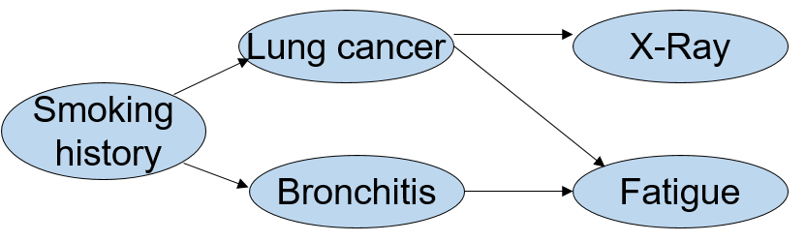
Inference in Bayesian Networks
Given a model and some data (“evidence”), how to update our belief?
What are the model parameters?

Slide 9
Inference in Bayesian Networks (cont’d)
Given a model and some data (“evidence”), how to update our belief?
E.g., for a patient with certain smoking history (non-smoker), whose X-ray result is positive, and who does not experience fatigue:
What is probability of having lung cancer?

Slide 10
Inference in Bayesian Networks (cont’d)
In a simple BN like this, we can compute the exact probabilities.
In general, for a tree-structured BN, we may use belief propagation for the inference problem.
For general structures, sometimes it is possible to generalize the above method (e.g., the junction tree algorithm). More often, we must resort to approximation methods
E.g. Variational methods, Sampling (Monte Carlo) methods.

Slide 11
Learning in Bayesian Networks
Learning parameters (probabilities) for a given BN (the graph is given).
Estimate the (conditional) probabilities from past data.
Learning both the structure and the parameters for a BN
A more challenging task beyond the scope of this discussion.

Slide 12
Learning the Probabilities
Basic ideas
Use relative frequency for estimating probability.
A prior distribution is typically assumed.
The prior is then updated by the data into posterior.
Using the MLE principle
The so-called “Expectation-Maximization (EM) Algorithm” is often used.
Iteratively update our guess for the parameter and each step attempts to apply the MLE principle.

Slide 14
Graphical Models
Hidden Markov Formulation
Notes:
Unit 5 Graphical Models
Module 2: HMM

Slide 15
Objectives
Objective
Objective
Introduce Hidden Markov Models
Illustrate HMM with intuitive examples
Notes:
Module 2:

Slide 16
Hidden Markov Models
Hidden Markov Models (HMMs) are a type of dynamic Bayesian Network
Modeling a process indexed by time
“Hidden”: the observations are due to some underlying (hidden) states not directly observable.
“Markov”: the state transitions are governed by a Markov process.

Slide 17
Discrete Markov Process
Consider a system which may be described at any time as being in one of a set of N distinct states, S₁, …, S_{N}.
At time instances t=1,2,3, …, the system changes its state according to certain probability. The full description requires us to know P(s^{t}=S_{j} | s^{t-1}=S_{i},s^{t-2}=S_{k}, …, s¹=S_{m}) for all t, i, k, …, m, where s^{t} stands for the state of the system at time t.
For a first-order Markov chain, we need to consider only
P(s^{t}=S_{j} | s^{t-1}=S_{i})
Further assume Ps are “stationary”:
a_{ij} = P(s^{t}=S_{j} | s^{t-1}=S_{i}), 1≤i,j≤N, for any t.

Slide 18
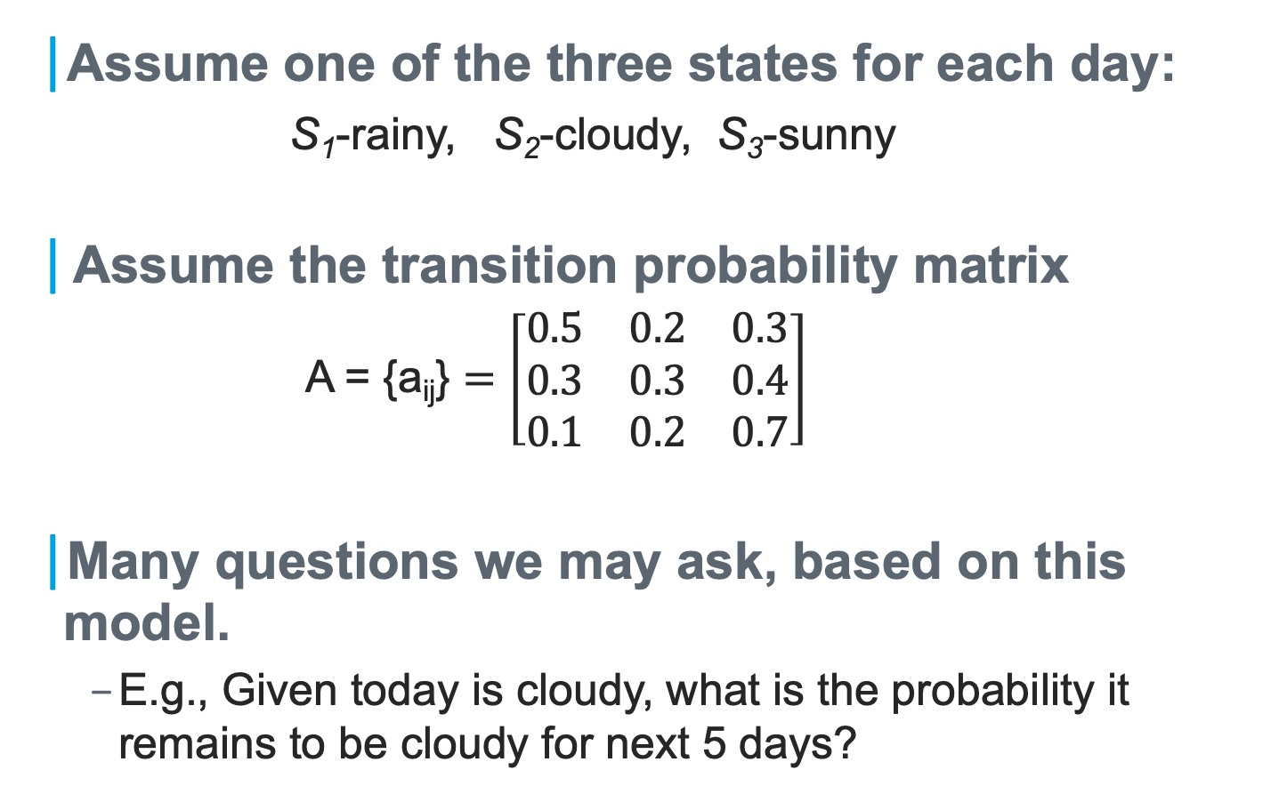
A Simple Example
Assume one of the three states for each day:
S₁-rainy, S₂-cloudy, S₃-sunny
Assume the transition probability matrix
A = {a_{ij}} $=\left[\begin{matrix}0.5 & 0.2 & 0.3 \\ 0.3 & 0.3 & 0.4 \\ 0.1 & 0.2 & 0.7\end{matrix}\right]$
Many questions we may ask, based on this model.
E.g., Given today is cloudy, what is the probability it remains to be cloudy for next 5 days?

Slide 19
Extending to “Hidden” States
The previous example is an “observable” Markov model: the output of the system/process is the states of interest.
Now assume that we can only measure the (average) temperature of a day
Further assume this measurement is useful for predicting the weather states (rainy, cloudy, sunny).
We can view the temperature values as being produced by the hidden states of interest, i.e., the weather.

Slide 20
A Simple HMM
rainy
cloudy
T₁
T₃
sunny
T₂

Slide 21
A Specific Process from the Model
rainy
cloudy
cloudy
sunny
cloudy
… t
70◦
72◦
75◦
78◦
77◦

Slide 22
Specifying an HMM
Θ: the set of hidden states.
The state transition probabilities a_{ij} = P(s^{t}=S_{j} | s^{t-1}=S_{i}), 1≤i,j≤N
Let A={a_{ij} } be the transition probability matrix
Ω: the set of outputs (observations).

Slide 23
Specifying an HMM (cont’d)
The observation probabilities: P(o^{t}|s^{t} ), where o^{t} stands for the observation at time t, given the state s^{t}. This is also called the emission probability.
For discrete observation space, we can define B={b_{jk}}=P(o^{t}=v_{k} at t|s^{t}=S_{j} ) as the emission probability matrix, where v_{k} is the k^{th} symbol in Ω
The initial state distribution π = {π_{i}}, π_{i}=P(s¹=S_{i})
Sometimes we are given an initial state, i.e., P(s¹=S_{i})=1 for certain i.

Slide 24
Basic Problems in HMM
For a given HMM Λ={Θ,Ω,A,B,π}
Problem 1: Given an observation (sequence) O={o¹,o², … ,o^{k}}, what is the most likely state sequence S={s¹,s², … ,s^{k}} that has produced O?
Problem 2: How likely is an observation O (i.e., what is P(O)) ?
Problem 3: How to estimate the model parameters (A,B,π)?

Slide 26
Graphical Models
Hidden Markov Models: Learning & Inference
Notes:
Unit 5 Graphical Models
Module 3: HMM Learning & Inference

Slide 27
Objective
Objective
Implement HMM learning & inference algorithms
Notes:
Module 3: HMM Learning & Inference algorithms

Slide 28
Basic Problems in HMM
For a given HMM Λ={Θ,Ω,A,B,π}
Problem 1: Given an observation (sequence) O={o¹,o², … ,o^{k}}, what is the most likely state sequence S={s¹,s², … ,s^{k}} that has produced O?
Problem 2: How likely is an observation O (i.e., what is P(O)) ?
Problem 3: How to estimate the model parameters (A,B,π)?

Slide 29
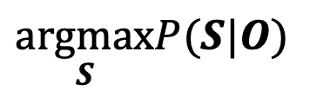
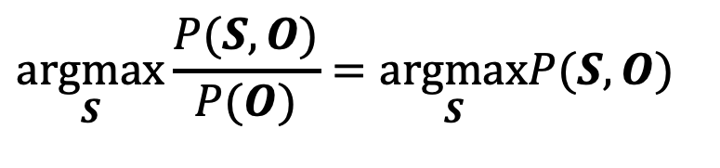
Problem 1: State Estimation
Given an observation (sequence) O={o¹,o², … ,o^{k}}, what is the most likely state sequence S={s¹,s², … ,s^{k}} that has produced O?
Formally, we need to solve
Or, equivalently,
$$\underset{S}{argmax}P(S|O)$$
$$\underset{}{\underset{S}{argmax}\frac{P(S,O)}{P(O)}=\underset{S}{argmax}}P(S,O)$$

Slide 30
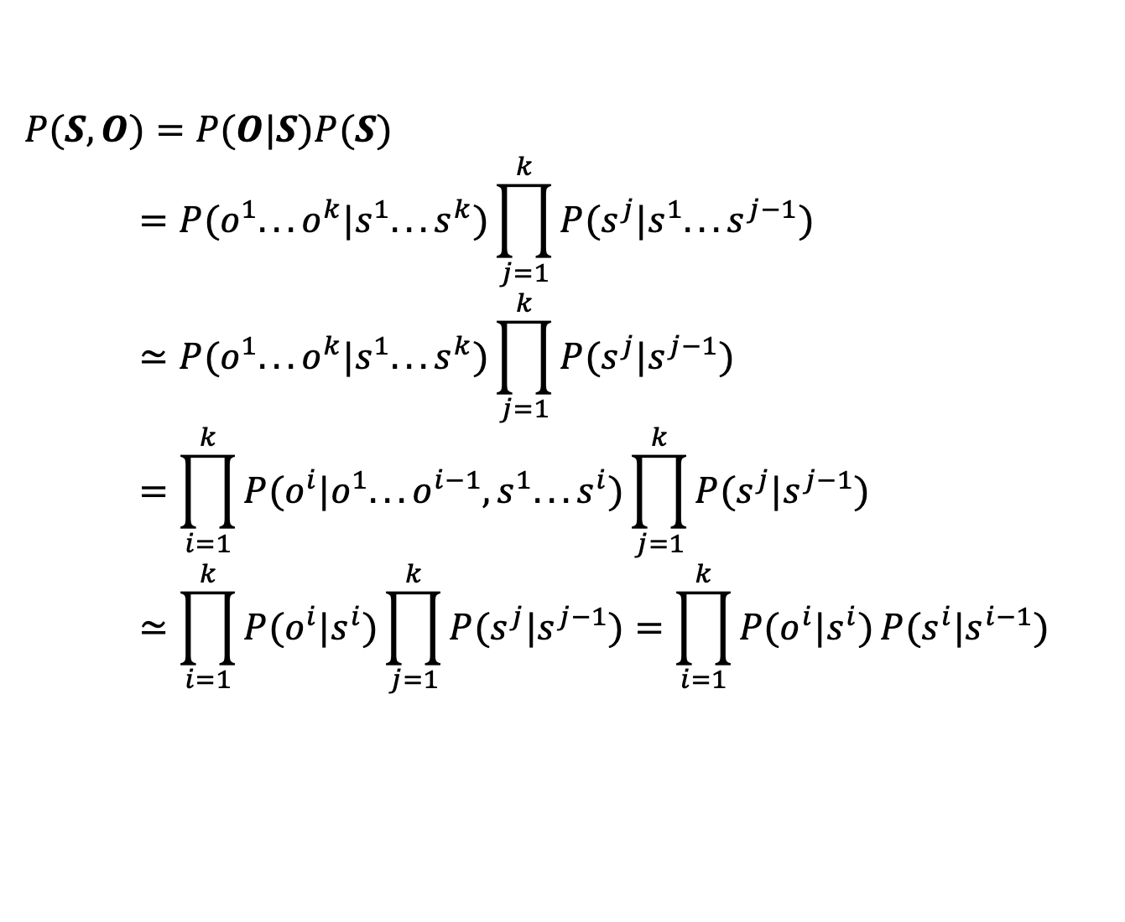
Problem 1: State Estimation (cont’d)
For a given HMM, we may simplify P(S,O) as
$$P(S,O)=P(O|S)P(S) \\ =P(o^{1}...o^{k}|s^{1}...s^{k})\prod_{j=1}^{k}{P(s^{j}|s^{1}...s^{j−1})} \\ ≃P(o^{1}...o^{k}|s^{1}...s^{k})\prod_{j=1}^{k}{P(s^{j}|s^{j−1})} \\ =\prod_{i=1}^{k}{P(o^{i}|o^{1}...o^{i−1},s^{1}...s^{i})}\prod_{j=1}^{k}{P(s^{j}|s^{j−1})} \\ ≃\prod_{i=1}^{k}{P(o^{i}|s^{i})}\prod_{j=1}^{k}{P(s^{j}|s^{j−1})}=\prod_{i=1}^{k}{P(o^{i}|s^{i})}P(s^{i}|s^{i−1})$$
Notes:
Two approximations where “=“ is only “about =“: the first one is because we assume conditionally independency of the states in a Bayesian net, and the second is conditionally independence of the observations.

Slide 31
The ”Weather” Example
Let’s expand the state space as a trellis, for the earlier example:
S₁-rain, S₂-cloudy, S₃-sunny
-- t(.|.) is the transition probability and e(.|.) the emission probability.
➔ To identify a path for which the product of t’s and the e’s is maximized.
t(S₁|S₁)
S₁
S₁
S₁
S₁
Initial state
…
…
…
…
S*
S₂
S₂
S₂
S₂
S₃
S₃
S₃
S₃
e(o²|S₃)
o¹
o²
o^{i}
o^{k}

Slide 32
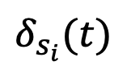

Viterbi Algorithm for Problem 1
A dynamic programming solution
For each state in the trellis, we record:
1. is the probability of taking the maximal path up to time t-1 ending at state S_{i} at time t and while generating o¹…o^{t}
2. is the state sequence that resulted in the maximal probability up to state S_{i} at time t.
$$δ_{s_{i}}(t)$$
$$ψ_{s_{i}}(t)$$

Slide 33

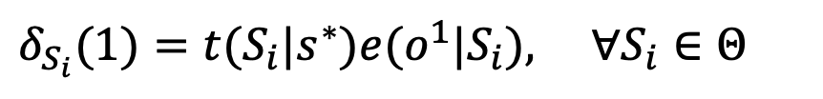
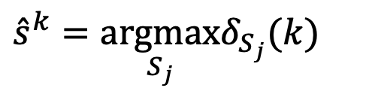

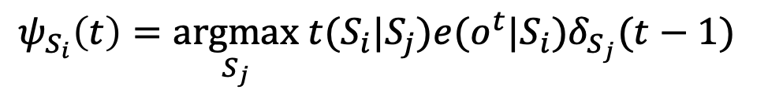
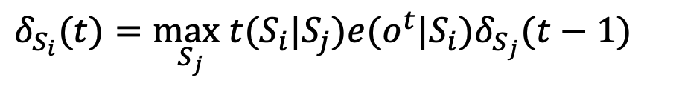
Viterbi Algorithm (cont’d)
$$δ_{S_{i}}(1)=t(S_{i}|s^{∗})e(o^{1}|S_{i}), ∀S_{i}∈Θ$$
Initialization
Induction:
for 2≤t≤k, do
Termination:
The probability of the best state sequence:
The best last state:
Back trace to get other states:
$$δ_{S_{i}}(t)=\max_{S_{j}}t(S_{i}|S_{j})e(o^{t}|S_{i})δ_{S_{j}}(t−1)$$
$$ψ_{S_{i}}\left(t\right)=\underset{S_{j}}{argmax} t(S_{i}|S_{j})e(o^{t}|S_{i})δ_{S_{j}}(t−1)$$
$$\max_{S_{j}}δ_{S_{j}}(k)$$
$${\hat{s}}^{k}=\underset{S_{j}}{argmax}δ_{S_{j}}(k)$$
$${\hat{s}}^{t}=ψ_{{\hat{s}}^{t+1}}(t), \text{for} t=k−1,...,1.$$

Slide 34
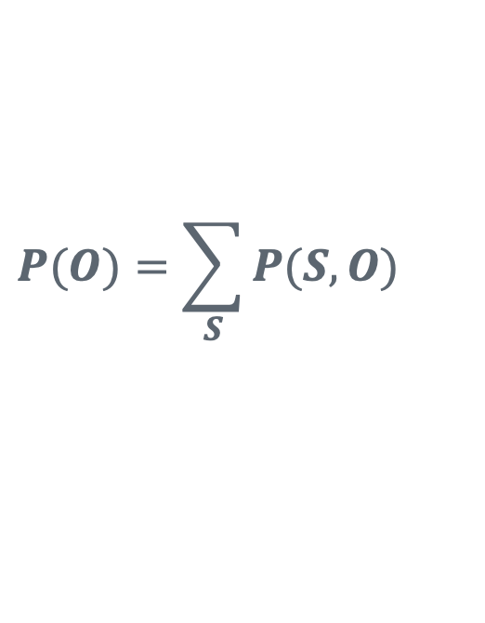
Problem 2: Evaluate P(O)
$$P(O)=\sum_{S}{P(S,O)}$$
To evaluate P(O), we can do
From the trellis, a solution can be found by summing the probabilities of all paths generating the given observation sequence.
A dynamic programming solution: the forward algorithm or the backward algorithm.
Notes:
Bullet 2: which would be expensive as we will have to first figure out all paths that can produce the given O sequence.

Slide 35
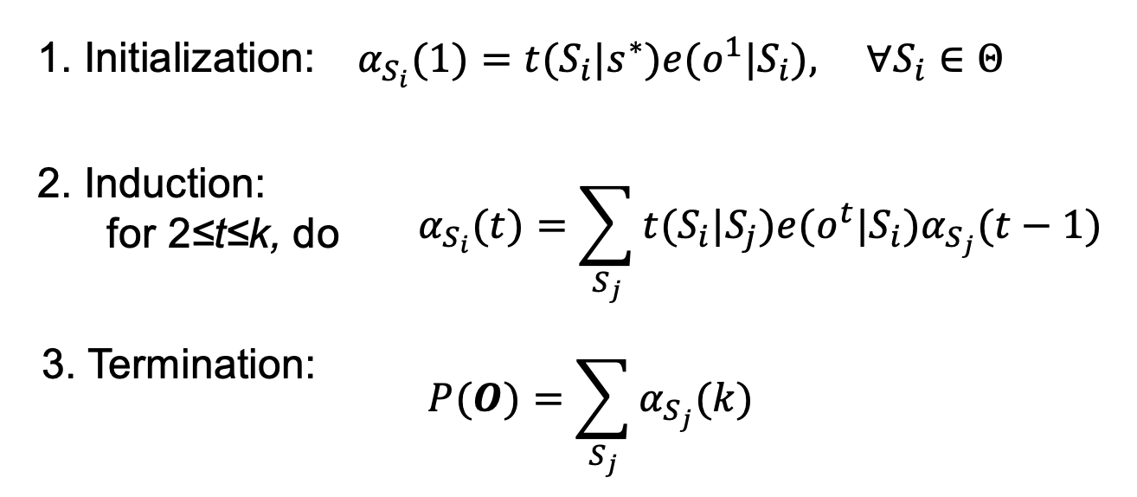
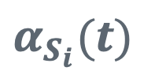
The Forward Algorithm
$$α_{S_{i}}(t)$$
Define the forward probability , which is the probability for all paths up to time t-1 ending at state S_{i} at time t and generating o¹…o^{t} .

Slide 36
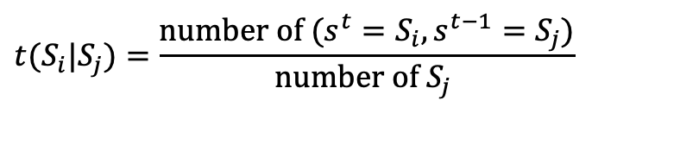
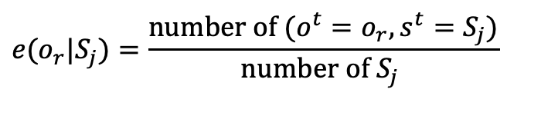
Problem 3: Parameter Learning
Case 1: we have a set of labeled data – sequences in which we have the <state, observation> information
Use relative frequency for estimating the probabilities
→ the MLE solution
Case 2: we have only the observation sequence
The Forward-Backward Algorithm (a.k.a. Baum-Welch Algorithm): An EM approach.
$$t(S_{i}|S_{j})=\frac{\text{number} \text{of} (s^{t}=S_{i},s^{t−1}=S_{j})}{\text{number} \text{of} S_{j} }$$
$$e(o_{r}|S_{j})=\frac{\text{number} \text{of} (o^{t}=o_{r},s^{t}=S_{j})}{\text{number} \text{of} S_{j} }$$

